Slide 1
Identifying Security Threats
Identify Types of Attackers
Identify Social Engineering Attacks
Identify Malware
Identify Software-Based Threats
Identify Network-Based Threats
Identify Wireless Threats
Identify Physical Threats

Slide 2




Hackers and Attackers
Hacker/attacker: Individuals who have the skills to gain access to computer systems through unauthorized or unapproved means.
Cracker: An individual who breaks encryption codes, defeats software copy protections, or specializes in breaking into systems.
Differing connotations
Neutral/benign vs. malicious
Different types

Slide 3
Hackers and Attackers (Cont.)
White hat: A hacker who discovers and exposes security flaws in applications and operating systems with an organization’s consent so that they can be fixed before they become widespread problems.
Black hat: A hacker who discovers and exposes security vulnerabilities without organizational consent, for financial gain or for some malicious purpose
Grey hat: A hacker who exposes security flaws in applications and operating systems without consent, but not ostensibly for malicious purposes.

Slide 4
Threat Actors
An entity that is partially or wholly responsible for an incident that affects or potentially affects an organization’s security. Also referred to as malicious actor.
Script kiddies
Hacktivists
Organized crime
Nation states
Insiders
Competitors

Slide 5
Threat Actors (Cont.)
Script kiddie: An inexperienced hacker with limited technical knowledge who relies on automated tools to hack.
Hacktivist: A hacker who gains unauthorized access to and causes disruption in a computer system to achieve political or social change.
Insider: Present and past employees, contractors, partners, and any entity that has access to proprietary or confidential information and whose actions result in compromised security.

Slide 6
Threat Actor Attributes
Type of Threat Actor | Attributes
Script kiddie | Internal or external? External. Level of sophistication: Simple code samples and automated attack tools. Resources/Funding: Minimal. Intent/Motivation: Gain attention or prove technical abilities.
Hacktivist | Internal or external? External. Level of sophistication: Varies. Resources/Funding: Varies. Intent/Motivation: Cause social or political change.
Organized crime | Internal or external? External. Level of sophistication: Highly sophisticated. Resources/Funding: Amply funded. Intent/Motivation: Monetary profit, through ransomware and data theft.

Slide 7
Threat Actor Attributes (Cont.)
Type of Threat Actor | Attributes
Nation states | Internal or external? External. Level of sophistication: Highly sophisticated. Resources/Funding: Amply funded. Intent/Motivation: Political, military, technical, or economic agendas.
Insiders | Internal or external? Internal. Level of sophistication: Varies. Resources/Funding: Varies. Intent/Motivation: Revenge, monetary gain, or even unintentional.
Competitors | Internal or external? External. Level of sophistication: Relatively high. Resources/Funding: Relatively high. Intent/Motivation: Monetary.

Slide 8
Open-Source Intelligence
Information that is legally collected from publicly available origins.
Sources:
Traditional media
Social networking
Public information
Professional and academic communications
Geospatial content
Deep web
Identification of relevant and accurate information is the key.
Practiced in both public and private sectors.

Slide 9
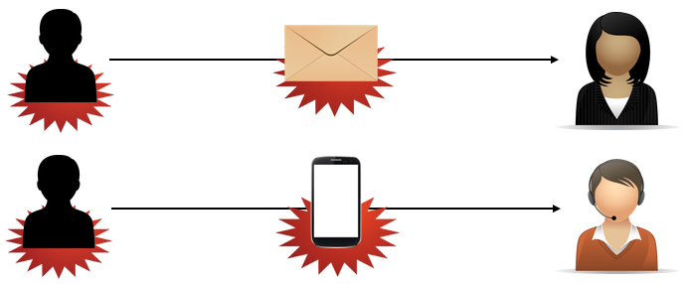
Social Engineering
Any activity where the goal is to use deception and trickery to convince unsuspecting users to provide sensitive data or to violate security guidelines.
Can be a precursor to other attacks.
Human factors can make symptoms hard to identify.
In person, through email, and on the phone.

Slide 10
Social Engineering (Cont.)
Attacker creates an executable to gather and store network user names and passwords, and uses email to send the executable to users. The email purports to be from IT, asking recipients to run the executable and provide their credentials to solve a network issue.
Attacker calls the Help Desk, pretending to be a remote sales rep who needs assistance establishing a remote connection.
Attacker sends an executable disguised as an e-card, OS patch, or application patch.

Slide 11
Effectiveness
Principle | Description
Authority | Posing as an authority figure, such as a manager or IT administrator.
Intimidation | Threatening someone’s job or financial situation.
Consensus | Taking advantage of the human tendency to be part of a group.
Scarcity | Offering something rare or of perceived value.
Familiarity | Impersonating a friend or family member.
Urgency | Encouraging swift action to gain a reward or avoid trouble.

Slide 12



Impersonation
A type of social engineering in which an attacker pretends to be someone they are not, typically an average user in distress, or a help desk representative.
Attacker
Unsuspecting user
Disguise

Slide 13
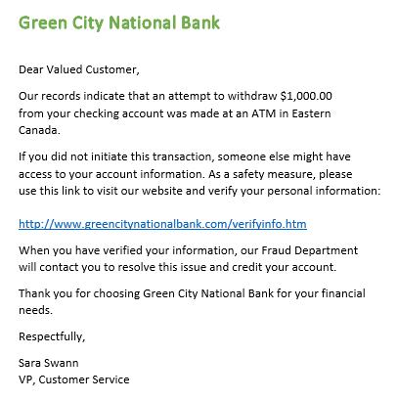
Phishing and Related Attacks
Phishing: A type of email-based social engineering in which an attacker sends email from a supposedly reputable source, such as a bank, to try to elicit private information from the victim.
Misspelling in bank’s name (should be Greene City)
Generic greeting
Allude to a security breach
Link purporting to be for official bank business

Slide 14
Phishing and Related Attacks (Cont.)
Spear phishing: A variant of a phishing attack where attackers target a specific individual or organization.
Whaling: A form of spear phishing that targets individuals or organizations known to be extremely wealthy.
Pharming: An attack where a request for a website (usually an e-commerce site) is redirected to a fake site that resembles the original site.
Vishing/voice phishing: A human-based attack where the attacker extracts information while speaking over the phone or leveraging IP-based voice messaging services (VoIP).
Smishing: A human-based attack where the attacker extracts information by using SMS text messages.

Slide 15
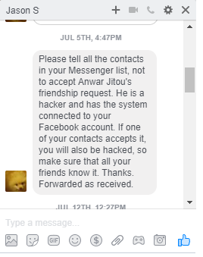
Hoaxes
An email-based, IM-based, or web-based social engineering attack that is intended to trick the user into performing undesired or unnecessary actions.
Virus or hacking threats
Free offers
Knowledge is power.

Slide 16
Physical Exploits
Physical Exploit | Description
Shoulder surfing | Goal: to obtain passwords or PINs by looking over someone’s shoulder. Cell phone cameras can make this easy to accomplish.
Dumpster diving | Goal: to obtain passwords and other information by inspecting a target’s refuse containers. January’s trash contains last year’s calendars, which might contain passwords or other sensitive information.
Tailgating | Goal: to gain entry to a secure area. Following an employee through an entrance without their knowledge. Prevent by implementing strict physical access controls and educating users.
Piggy backing | Goal: to gain entry to a secure area. Following an employee through an entrance with their knowledge. Attackers might impersonate support staff or vendors and request that an employee hold the door for them.

Slide 17





Watering Hole Attacks
An attack in which an attacker targets a specific group, discovers which websites that group frequents, then injects those sites with malware.
1. Attacker identifies websites used by target users.
2. Attacker infects websites.
3. One or more target users is compromised.

Slide 18







Malicious Code
Malicious code: Undesired or unauthorized software that is placed on a target computer to disrupt operations or to redirect system resources for the attacker’s benefit.
Malware: Malicious code, such as viruses, Trojans, or worms, which is designed to gain unauthorized access to, make unauthorized use of, or damage computer systems and networks.

Slide 19


Malicious Code (Cont.)
Rootkit: Software that is intended to take full or partial control of a system at the lowest levels.
Administrative access granted

Slide 20





Viruses
A piece of malicious code that spreads from one computer to another by attaching itself to other files through a process of self-replication.
Human action triggers self-replication.
Can be used to:
Enable additional attacks.
Gather data.
Corrupt or destroy data.

Slide 21
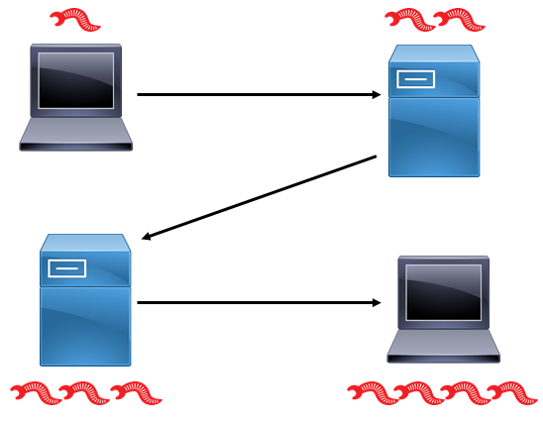
Worms
Malware that spreads from computer to computer without attaching itself to different files.
No human trigger necessary.
Primary function is to spread.
Can cause problems with network bandwidth.
If there is a payload, it is probably to take control of the computer.

Slide 22


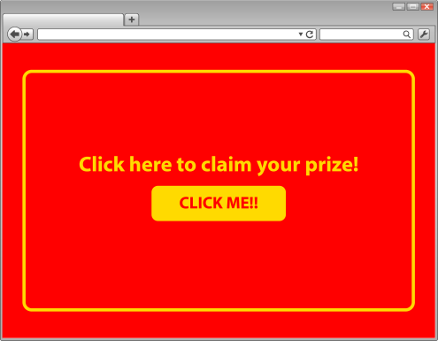
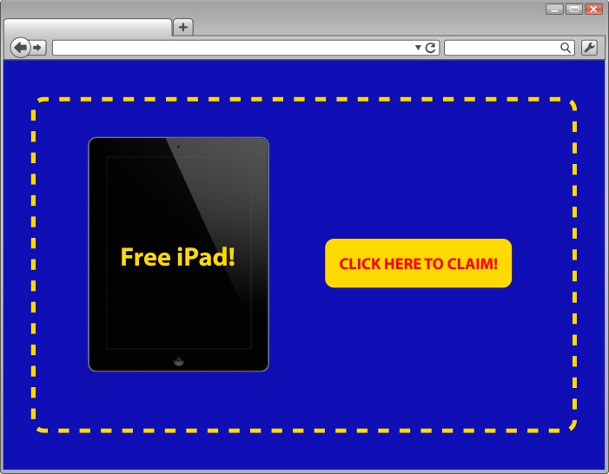
Adware
Software that automatically displays or downloads advertisements when it is used.
Unsolicited advertising.
Often implemented as browser pop-ups.
Chance of spyware or other malware.

Slide 23


Spyware
Surreptitiously installed malware that is intended to track and report the usage of a target system or collect other data the attacker wishes to obtain.
Collected data:
Web browser history
Personal/financial information
User names and passwords
Can be bundled with legitimate software.

Slide 24
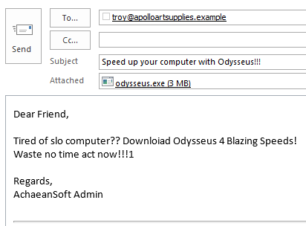

Trojan Horses
A type of malware that hides itself on an infected system and can cause damage to a system or give an attacker a platform for monitoring and/or controlling a system.
Not self-replicating.
Not attached to other files.
Malicious content in a benign package.

Slide 25
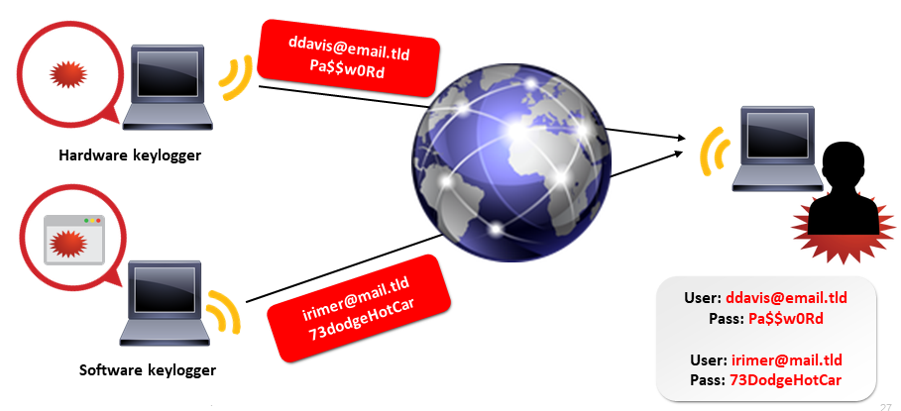
Keyloggers
A hardware device or software application that recognizes and records every keystroke made by a user.
Capture passwords and other sensitive data.
Can affect the security of keystroke authentication.

Slide 26


Remote Access Trojans
A specialized Trojan horse that specifically aims to provide an attacker with unauthorized access to or control of a target computer.
Mimic the behavior of legitimate remote control applications.
Can hide in games and other applications.
Downloads and email attachments.
Email attachment or other means to disguise executables
Backdoor access to hardware and software resources

Slide 27




Logic Bombs
Software that sits dormant on a target computer until it is triggered by the occurrence of specific conditions, such as a specific date and time.
When the software is triggered, it detonates the logic bomb.
Erases or corrupts data on the target.

Slide 28
Botnets
Botnet: A set of computers that has been infected by a control program called a bot that enables attackers to collectively exploit those computers to mount attacks.
Zombie/Drone: A computer that has been infected with a bot and is being used by an attacker to mount an attack.
Botnet attack goals:
Denial of service attack coordination
Send spam emails
Mine for personal information and passwords
Activity may not be detected by users.

Slide 29


Botnets (Cont.)
Botnet
DoS target
Attacker/ Botmaster
Command/Control servers
Zombies

Slide 30
Ransomware
Ransomware: Software that enables an attacker to take control of a user’s system or data and to demand payment for return of that control.
Bitcoin: A decentralized, encrypted electronic payment system that is used by legitimate entities and threat actors alike.
Crypto-malware: A form of ransomware that uses encryption to render the victim’s data inaccessible.
Attacker places ransomware on victim computer.
Attacker demands ransom for reestablishing access to data.
Continues to be a major threat.
WannaCry

Slide 31
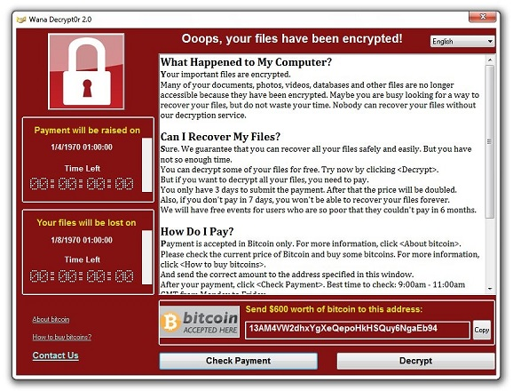
Ransomware (Cont.)

Slide 32
Advance Persistent Threats
A threat that uses multiple attack vectors to gain unauthorized access to sensitive resources and then maintains that access for a long period of time.
Long-range, repeated threats.
Malware-induced.
Target private organizations (financial or educational institutions) or nation states.
APTs cover their own tracks to remain undetected.

Slide 33
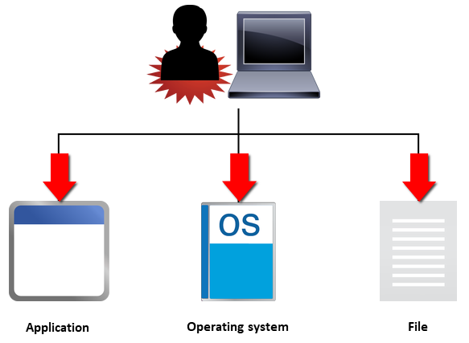
Software Attacks
Any attack that targets software resources, including operating systems, applications, services, protocols, and files.
Disrupt or disable the software running on the target.
Exploit the target to gain access to resources.
Gain secret control.

Slide 34

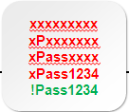
Password Attacks
Any attack where the attacker tries to gain unauthorized access to and use of passwords.
Guessing and cracking
Can be found in audit logs
Repeated failed logon attempts, then success
Successful logons at unusual times

Slide 35
Types of Password Attacks
Password Attack Type | Description
Guessing | Individual, repeated attempts to guess a password Use different common password values User's name Spouse's name A significant date
Stealing | Sniffing network communications Reading handwritten password notes Observing a user in the act of entering a password (shoulder surfing)
Dictionary attack | Automated password guessing Compares passwords against a list of possible values Dictionary words and variants Letter substitution Appending numerals
Brute force attack | Use password-cracking software Try every possible alphanumeric combination For cracking encrypted passwords

Slide 36
Types of Password Attacks (Cont.)
Password Attack Type | Description
Rainbow table attack | Use plaintext passwords and their hashes to crack passwords. Generate hashes in advance. Trade time saved for disk space. Compare target hash to table entries.
Hybrid password attack | Use multiple attack methods when trying to crack a password. Dictionary attack. Rainbow table attack. Brute force attack.
Birthday attack | Exploit weaknesses in the algorithms used to generate hashes. Identify what different inputs produce the same output.

Slide 37






Cryptographic Attacks
A software attack that exploits weaknesses in cryptographic system elements, such as code, ciphers, protocols, and key-management systems.
Primarily used to decipher encrypted passwords.

Slide 38
Types of Cryptographic Attacks
Cryptographic Attack Type | Description
Known plaintext attack (KPA) | Attacker has a plaintext message and its corresponding ciphertext. Attacker tries to derive the correlation between them to determine the encryption key.
Chosen plaintext attack | Attacker encrypts a selected plaintext message. Attacker analyzes the resulting ciphertext to crack the cipher. Attacker uses attack results to iteratively repeat the attack for an adaptive chosen plaintext attack.
Ciphertext-only attack | Attacker has access to ciphertext. Attacker tries to use frequency analysis or other methods to break the cipher.
Chosen ciphertext attack | Attacker analyzes a selected ciphertext message and tries to find the matching plaintext. Attacker uses the attack results to iteratively repeat the attack for an adaptive chosen ciphertext attack.

Slide 39
Types of Cryptographic Attacks (Cont.)
Cryptographic Attack Type | Description
Downgrade attack | Attacker exploits the need for backward compatibility. Attacker forces a computer to abandon the use of encrypted messages in favor of plaintext messages.
Replay attack | Attacker intercepts session keys or authentication traffic. Attacker uses them later to authenticate and gain access.
Weak implementation attacks | Focus on how the cryptographic system is implemented. (Other cryptographic attacks focus on the algorithm used to encrypt the targeted data.)

Slide 40
Backdoor Attacks
Backdoor attack: An attack where the attacker uses a software application or bogus user account to gain access to a system and its resources.
Backdoor: A mechanism for gaining access to a computer that bypasses or subverts the normal authentication methods.
Typically delivered via Trojan or other malware.
Backdoor software listens for commands on an open port.
Attacker can send commands and disrupt the target computer.
Backdoor access not always detected, so it can be persistent.
Takeover attack: A software attack that provides remote access and control.

Slide 41


Backdoor Attacks (Cont.)
Backdoor account

Slide 42
Application Attacks
Application attack: A software attack that targets web-based and other client-server applications.
Threaten app and web servers, users, back-end systems, and the software itself.
Lead to authentication breaches, impersonation, information disclosure, source code issues, and other breaches
Source code: Software instructions, written in a human-readable programming language, that get compiled into machine code to be executed by a computer.

Slide 43
Application Attacks (Cont.)
Client-side attack: A software attack that exploits the trust relationship between a client and the server it connects to.
Web application attack: An application attack that focuses on those applications that run in web browsers.
Known flaws in applications provide access to web and client-server applications.

Slide 44
Types of Application Attacks
Application Attack Type | Description
Cross-site scripting (XSS) | Injects malicious scripts into trusted websites. Scripts to run when a user visits the site. Similar to watering-hole attacks.
XSRF | Takes advantage of the trust established between an authorized user of a website and the website itself. Exploits a web browser's trust in a user's unexpired browser cookies. Target websites use input from trusted authenticated users who use browser cookies to automatically authenticate.
Command injection attacks | SQL injection. LDAP injection. XML injection. Directory traversal.
Zero day exploit | Attack that occurs immediately after a vulnerability is identified. The protection level is at its lowest.
Buffer overflow | Exploits fixed data buffer sizes in a target piece of software. Sends data that is too large for the buffer, causing the application to crash.

Slide 45
Driver Manipulation
Driver manipulation: A software attack where the attacker rewrites or replaces the legitimate device driver or application programming interface (API) to enable malicious activity to be performed.
Shimming: The process of developing and implementing additional code between an application and the operating system to enable functionality that would otherwise be unavailable.
Refactoring: The process of restructuring application code to improve its design without affecting the external behavior of the application, or to enable it to handle particular situations.

Slide 46
Privilege Escalation
The practice of exploiting flaws in an operating system or other application to gain a greater level of access than was intended for the user or application.
Vertical escalation (elevation)
Where a user or application is able to access functionality or data that should not be available to them.
Horizontal escalation
Where a user accesses functionality or data that is intended for another user.

Slide 47



Privilege Escalation (Cont.)
Vertical escalation
Group
Escalated user
ACL: Read Only
ACL: Read/Write/Delete

Slide 48
TCP/IP Basics
Standard network protocol in use worldwide.
Layered suite of multiple protocols.
Enables communication between hosts.
Host addresses and host names.
Three-way handshake: The process by which a TCP connection is completed between two hosts.
1
SYN packet
SYN-ACK packet
2
3
ACK packet

Slide 49

TCP/IP Basics (Cont.)
Network Interface/ Data Link
Internet
Transport
Application

Slide 50
Spoofing Attacks
A network-based attack where the goal is to pretend to be someone else for the purpose of identity concealment.
IP address spoofing
MAC address spoofing
ARP poisoning/spoofing
DNS poisoning/spoofing

Slide 51

IP and MAC Address Spoofing
IP address spoofing: A spoofing attack where the attacker sends IP packets from a false source address to communicate with targets.
Spoofed packets
IP address: 206.49.158.12
False IP address: 206.149.18.227

Slide 52


IP and MAC Address Spoofing (Cont.)
MAC address spoofing: A spoofing attack where the attacker reconfigures a network interface to disguise the original MAC address.
Data for server
Server MAC address: 00-14-22-56-13-86
MAC address: 00-14-22-52-93-08
False MAC address: 00-14-22-56-13-86
Traffic intended for the server is delivered to the spoofed MAC address instead.

Slide 53
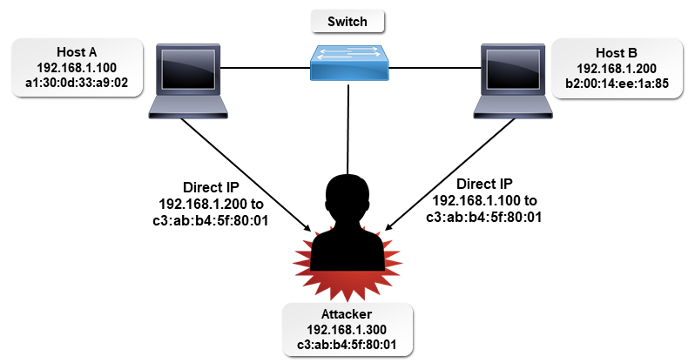
ARP Poisoning
A network-based attack where an attacker with access to the target network redirects an IP address to the MAC address of a computer that is not the intended recipient. Also known as ARP spoofing.
Capture, alter, and forward network traffic to intended recipient.
Create denial of service by pointing to a non-existent MAC address.

Slide 54
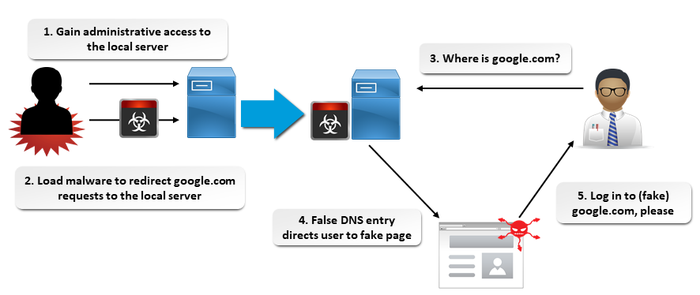
DNS Poisoning
A network-based attack where an attacker exploits the open nature of DNS to redirect a domain name to a different IP address. Also known as DNS spoofing.
Capture data from domain name visitors.
Serve malware to domain name visitors.
Create denial of service by pointing to a non-existent IP address.

Slide 55
Port Scanning Attacks
Port: An endpoint of a logical connection that host computers use to connect to processes or services on other hosts.
Port scanning attack: A network-based attack where an attacker scans computers and other devices to see which ports are listening, in an attempt to find a way to gain unauthorized access.
TCP and UDP ports scanned.
Active services scanned.
Can be automated.
Likely to occur, whether you’re aware of it or not.

Slide 56
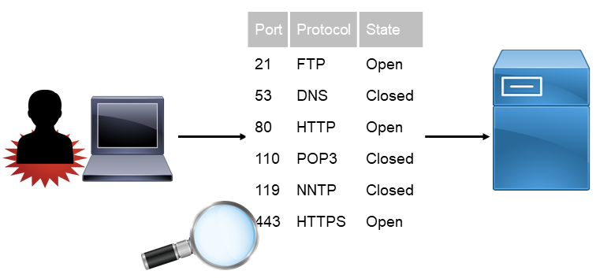
Port Scanning Attacks (Cont.)

Slide 57
Scan Types
Stealth scan: A type of port scan that identifies open ports without completing the three-way handshake.
Attacker sends SYN; target sends SYN-ACK; attacker resets the connection.
Less likely to be logged.
Stealth scan
1
SYN packet
SYN-ACK packet
2
List of open ports
Indicates that the port is open and listening.

Slide 58
Scan Types (Cont.)
Full connect scan: A type of port scan that completes the three-way handshake, identifies open ports, and collects information about network hosts by banner grabbing.
Banner grabbing: The act of collecting information about network hosts by examining text-based welcome screens that are displayed by some hosts.
Easiest scanning method
Supports banner grabbing
Full connect scan
1
SYN packet
SYN-ACK packet
2
3
ACK packet
List of open ports OS information Service packs Other information
Three-way handshake completed

Slide 59





Eavesdropping Attacks
Eavesdropping attack/sniffing attack: A network attack where an attacker uses special monitoring software to gain access to private communications on the network wire or across a wireless network.
Stealing content.
Gathering user names and passwords for future attacks.
On wired networks, physical access to the network is required.
On wireless networks, a device capable of receiving wireless network signals is required.
Hard to detect.

Slide 60
Man-in-the-Middle Attacks
A form of eavesdropping where the attacker makes an independent connection between two victims and steals information to use fraudulently.
Two victims.
2 clients.
1 client and 1 server.
Attacker controls information flow between victims.
Can steal, modify, and forward data to victims.
ARP poisoning.

Slide 61
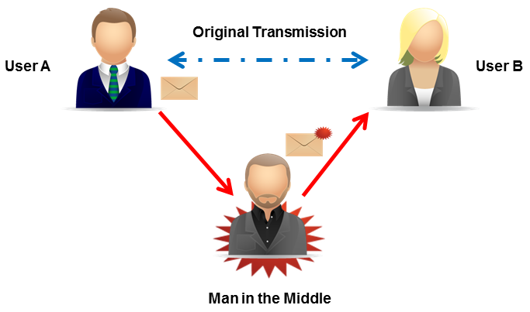
Man-in-the-Middle Attacks (Cont.)

Slide 62
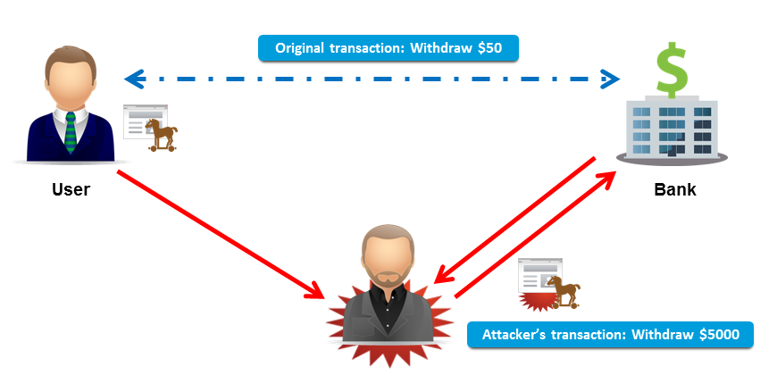
Man-in-the-Browser Attacks
A type of network-based attack that combines a man-in-the-middle attack with the use of a Trojan horse to intercept and modify web transactions in real time.
Trojan modifies victim’s web browser via extensions or scripts.
Gather personal information.
Prompt for creating token-based password or transaction PIN.
Altered credentials used to redirect funds or information.

Slide 63
Replay Attacks
A type of network-based attack where an attacker captures network traffic and stores it for retransmitting at a later time to gain unauthorized access to a specific host or a network.
Capture user names, passwords, and other authentication data.
Often go undetected.

Slide 64
Replay Attacks (Cont.)
10:00 A.M.
1:00 P.M.

Slide 65
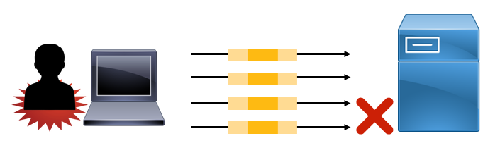
DoS Attacks
A type of network-based attack where the attacker tries to disrupt or disable systems that provide network services.
Consume network link’s available bandwidth.
Consume a single system’s available resources.
Exploit programming flaws in OSs and apps.
Overload email Inbox.
Can use IP spoofing two ways.
Flood selected target from spoofed source addresses.
Spoof target address and send data to multiple recipients.

Slide 66
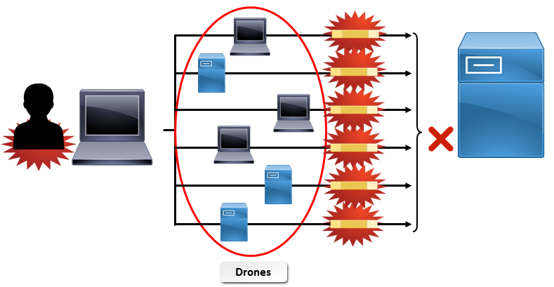
DDoS Attacks
A network-based attack where the attacker uses multiple computers on disparate networks to launch a DoS attack from many simultaneous sources.
Use unauthorized software to create bots and a botnet.
May or may not step from malicious intent.
Slashdot effect.

Slide 67
Hijacking Attacks
A group of network-based attacks where the attacker gains control of the communication between two systems, often masquerading as one of the entities.
Hijacking Attack Type | Description
Clickjacking | An attacker hides links under other web page elements. Victims unintentionally select the hidden links.
DNS hijacking | An attacker sets up a rogue DNS server. The rogue server responds to legitimate requests with IP addresses for malicious or non-existent websites.
Domain hijacking | An attacker steals a domain name. Domain registration information altered and transferred. Sometimes referred to as brandjacking.

Slide 68
Hijacking Attacks (Cont.)
Hijacking Attack Type | Description
Session hijacking | An attacker exploits a legitimate computer session. The goal is to obtain unauthorized access to an organization's network or services. Stealing session cookies, using sequence prediction and command injection, and using ARP poisoning.
URL hijacking/ Typo squatting | An attacker registers domain names that closely resemble the names of legitimate websites. The goal is to take advantage of the possibility of the domain name being mistyped into a browser.

Slide 69
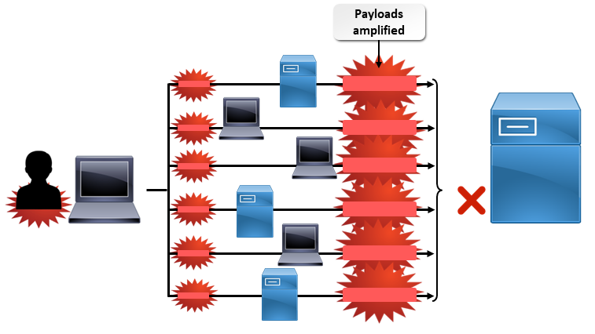
Amplification Attacks
A network-based attack where an attacker dramatically increases the bandwidth sent to a victim during a DDoS attack.
ICMP, DNS, UDP, or NTP.
Amplification factor.
Small request invokes large payload.

Slide 70
Amplification Attacks (Cont.)
Attack Type | Description
ICMP amplification | Known as Smurf attacks. Based on sending high volumes of ICMP ping packets to a target. Less prevalent with advances in routing.
DNS amplification | Attacker sends a DNS query (with a spoofed IP address) to a DNS server so that the target receives a DNS response packet. Requesting additional information increases the size of the response packet.
UDP amplification | Leverage network services to amplify their effects. DNS amplification. Fraggle attacks: Based on sending high volumes of UDP packets to a target. Less prevalent with advances in routing.
NTP amplification | A type of UDP amplification attack. Sending monlist requests result in response packets 556.9 times larger than the request.

Slide 71
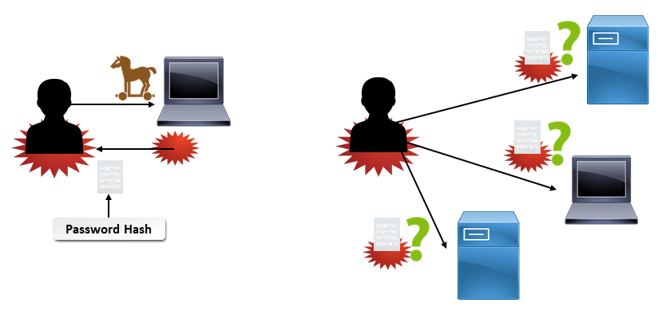
Pass the Hash Attacks
A network-based attack where the attacker steals hashed user credentials and uses them as-is to try to authenticate to the same network the hashed credentials originated on.
No need for password cracking.
Affects Windows-based systems.
SSO protocols like NTLM and Kerberos.
Administrative privileges needed to access cached credentials.

Slide 72


Rogue Access Points
An unauthorized wireless access point on a corporate or private network that allows unauthorized individuals to connect to the network.
Not easily detected.
Can allow man-in-the-middle attacks.
Access to private information.
Rogue

Slide 73
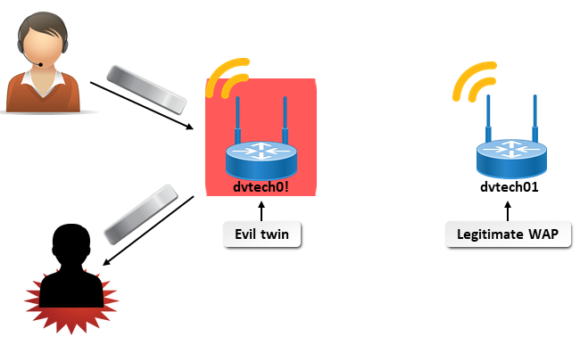
Evil Twins
Unauthorized wireless access points that deceive users into believing that they are legitimate network access points.
Corporate networks, private networks, and public Wi-Fi hotspots.
Common where you connect to a wireless network by selecting it from a list.
Often named similarly to a valid AP.

Slide 74

Jamming
A situation where radio waves from other devices (benign or malicious) interfere with the wireless signals used to communicate over wireless networks. Also referred to as interference.
Common in home networks where other devices operate in neighboring bandwidths.
Can use a radio transceiver to jam and intercept transmissions.

Slide 75
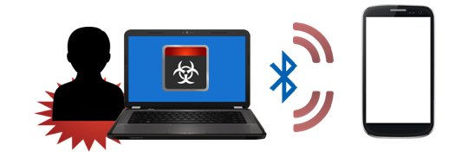
Bluejacking
Bluejacking: A wireless attack where an attacker sends unwanted Bluetooth signals from a smartphone, mobile phone, tablet, or laptop to other Bluetooth-enabled devices.
Bluetooth: A short-range wireless radio network transmission medium normally used to connect two personal devices, such as a mobile phone and a wireless headset.
Close-range attack (10 to 100 meters).
Can send messages, images, and videos.
Device malfunction and malware infestation.

Slide 76

Bluesnarfing
A wireless attack where an attacker gains access to unauthorized information on a wireless device by using a Bluetooth connection.
Close-range attack.
Bluetooth transmission limit is 328 feet.
Can access and steal private information from Bluetooth devices.
Email messages.
Contact information.
Calendar entries.
Images, videos, and other data.

Slide 77
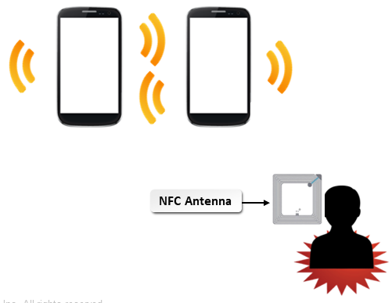
Near Field Communication Attacks
NFC: A communication standard for wireless devices in close physical proximity (touching or a few inches apart).
In-person transactions and data exchange.
Android Pay, Apple Pay, and Samsung Pay.
Very-close range attack.

Slide 78



RFID System Attacks
RFID: A technology that uses electromagnetic fields to automatically identify and track tags or chips affixed to selected objects and storing information about the objects.
Tag and reader.
Inventory management and tracking.
Human and animal identification and tracking.
Contactless payments.
Smart cards.
Contactless RFID reader
RFID chip

Slide 79
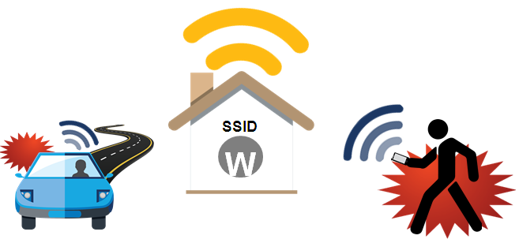
War Driving, War Walking, and War Chalking
War driving/walking: A wireless threat where an attacker searches for wireless LAN networks while in motion, by using wireless devices such as mobile phones, smartphones, tablets, and laptops.
War chalking: A wireless threat where the attacker uses symbols to mark up a sidewalk or wall to indicate the presence and status of a nearby wireless network.

Slide 80

Packet Sniffing
A wireless attack where an attacker uses a protocol analyzer to capture data and register data flows.
Often a precursor to other attacks.
Can help organizations monitor their own networks and prevent attacks.
Less common on wired networks when managed switches are used.
Protocol analyzer

Slide 81
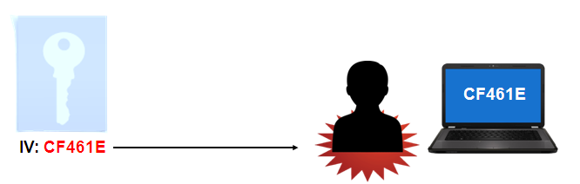
IV Attacks
IV: (Initialization vector) A cryptographic technique that combines randomly generated numbers and secret keys to encrypt data.
IV attack: A wireless attack where the attacker predicts or controls the IV used in an encryption process, rendering the encrypted data vulnerable to access by the attacker.
CF461E

Slide 82
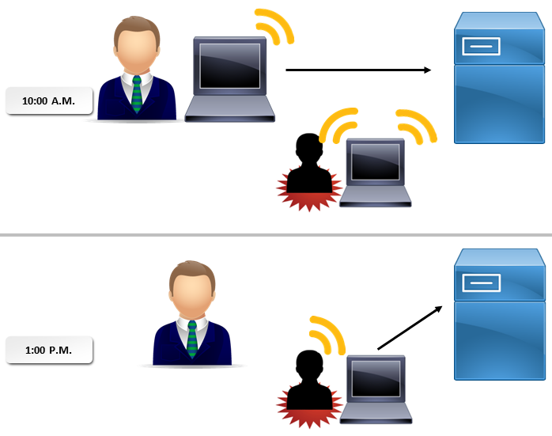
Wireless Replay Attacks
Common when weak or no wireless encryption is implemented.
Used with IV attacks to break weak encryption.

Slide 83
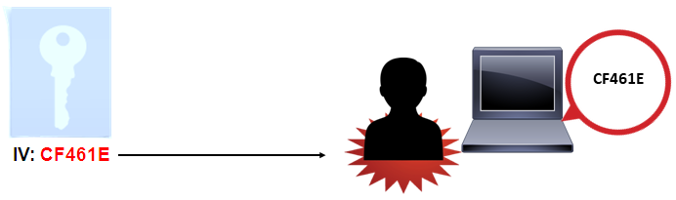
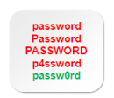
WEP and WPA Attacks
WEP: (Wired Equivalent Privacy) A deprecated protocol that provides 64-bit, 128-bit, and 256-bit encryption for wireless communications using the 802.11a and 802.11b protocols.
WPA: (Wi-Fi Protected Access) A wireless encryption protocol that generates a 128-bit key for each packet sent. Superseded by WPA2.
WEP
WPA
Passphrase

Slide 84
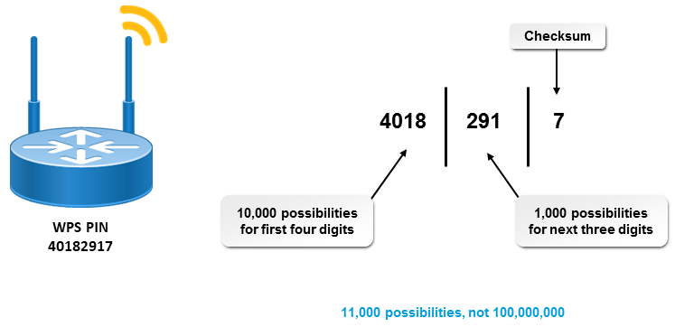
WPS Attacks
A wireless attack where an attacker leverages the insecure nature of WPS that allows wireless network connections based on an 8-digit PIN to drastically reduce the number of attempts it takes to crack the PIN.
Intended to strengthen wireless security, but fell short.
How WPS checks the WPS PIN enables it to be cracked in hours.
Enabled by default.
Disable when possible.
Limit physical access to the devices.

Slide 85

Wireless Disassociation
A wireless attack where an attacker spoofs the MAC address of a wireless access point to force a target device to try and reassociate with the WAP.
Wireless device authenticates to and associates with a WAP.
Wireless disassociation forced by attacker.

Slide 86



Physical Threats and Vulnerabilities
General threats and vulnerabilities associated with risk assessment.
Unauthorized access to facilities and hardware.
Environmental issues that can damage or change access to physical resources.
Equipment theft.
Sell gear for quick cash.
Sell information to interested parties.

Slide 87




Hardware Attacks
An attack that targets a computer's physical components and peripherals, including its hard disk, motherboard, keyboard, network cabling, or smart card reader.
Destruction of hardware.
Acquiring sensitive information.
Render data and devices unavailable to the owners.

Slide 88
Environmental Threats and Vulnerabilities
Environmental Threat | Effects and Mitigation Factors
Fire | Can destroy hardware and the data contained in it. Hazardous to people and systems. Install systems in a fire-resistant facility, and install high-quality fire detection and suppression systems.
Catastrophic weather events | Hurricanes and tornadoes can cause severe damage to hardware and data. Ensure that information systems are well contained and that the physical structure is built to appropriate codes and standards.
Flood | Floods can cause as much damage as fire can. Check to see if you are in a flood plain before constructing a physical building. Follow appropriate building codes and obtain flood insurance. When possible, construct the building so that the lowest floor is above flood level.

Slide 89
Environmental Threats and Vulnerabilities (Cont.)
Environmental Threat | Effects and Mitigation Factors
Extreme temperature | Heat degrades hardware components. Implement temperature controls and monitors.
Extreme humidity | Can cause rust, deterioration, and degradation. Implement adequate ventilation and humidity controls and monitors.

Slide 90
Reflective Questions
What type of attack is of the most concern in your environment?
Which type of attack do you think might be the most difficult to guard against?

